Slide 1


A Project Based Learning project
Desktop Voice Assistant
Presented by
Name | Roll No. | Seat No.
Sarang Deshpande | 2116 | S1901004229
Uday Dherange | 2117 | S1901004391
Akshad Ambekar | 2103 | S1901004204
Sai Abhang | 2101 | S190100
Under the guidance of Prof. A. R. Nehe
Amrutvahini College of Engineering, Sangamner

Slide 2
CONTENTS
Introduction
Need for project
Problem Statement/Aim
Objectives
Literature Review
Methodology/ Flow chart
Design of Model
Assembly and working of Model
Results of project and discussions
Conclusion
Future scope
References

Slide 3
Introduction
Project on a Python-based voice assistant involves designing and building a voice-controlled assistant that can perform basic tasks based on user commands as it is free of source. The goal of the project is to develop an assistant that can understand natural language input, process it using various Python libraries, and respond with appropriate output.

Slide 4
Need of the Project
What is the need of this project ?
Why we design this project ?
There are several reasons why there is a need for voice assistants in today's world. Here are a few :
Convenience: Voice assistants allow users to interact with technology hands-free, making tasks more convenient and efficient. Users can ask for temperature, current news, play music, and control smart devices, among other tasks, without having to physically interact with their devices
Personalization: Voice assistants can learn about a user's preferences and behavior patterns, allowing them to provide personalized recommendations and suggestions. This can help users save time and make their lives easier.
Efficiency: Voice assistants can complete tasks quickly and accurately, reducing the time and effort required by the user. For example, a user can ask a voice assistant to set a reminder, for specific task, which can be done much faster than if they had to do it manually. Overall, the need for voice assistants is driven by the desire for convenience, accessibility, personalization, and efficiency.

Slide 5
Problem Statement/Aim
We all are well aware about Siri, Google Assistant and many other virtual assistants which are designed to aid the tasks of users in Windows, Android and iOS platforms. But to our aim is to know how these things actually work.
It looks very fascinating how these application works and we aspire to tell everyone how using some coding knowledge these can be developed.

Slide 6
Objectives
1) It keeps listening continuously in inaction and wakes up into action when called with a particular predetermined functionality.
2) Browsing through the web based on the individual’s spoken parameters and then issuing a desired output through audio and at the same time it will print the output on the screen. Other useful services such as playing kind of news, browsing weather forecasts, play music, reminders, shut down computer, sending an Email etc. Are provided as a result of spoken commands.

Slide 7
Literature Review
Sr. No | Authors | Name of Topic | Major Findings
1 | Sowmya Vajjala. & Anuj Gupta. | “Practical natural Language Processing” | A Comprehensive Guide to build Real-World NLP Systems
2 | Jalaj Thanali. | “Python Natural Language Processing” | a broad topic that encompasses various techniques and tools for processing and analyzing natural language using the Python programming language.
3 | Sebastian Raschka. & Vahid Mirjalili. | “Python Machine Learning” | How AI works for specifically for voice assistant.

Slide 8
Methodology
Analysis
Coding
Testing
Modification
Implementation

Slide 9

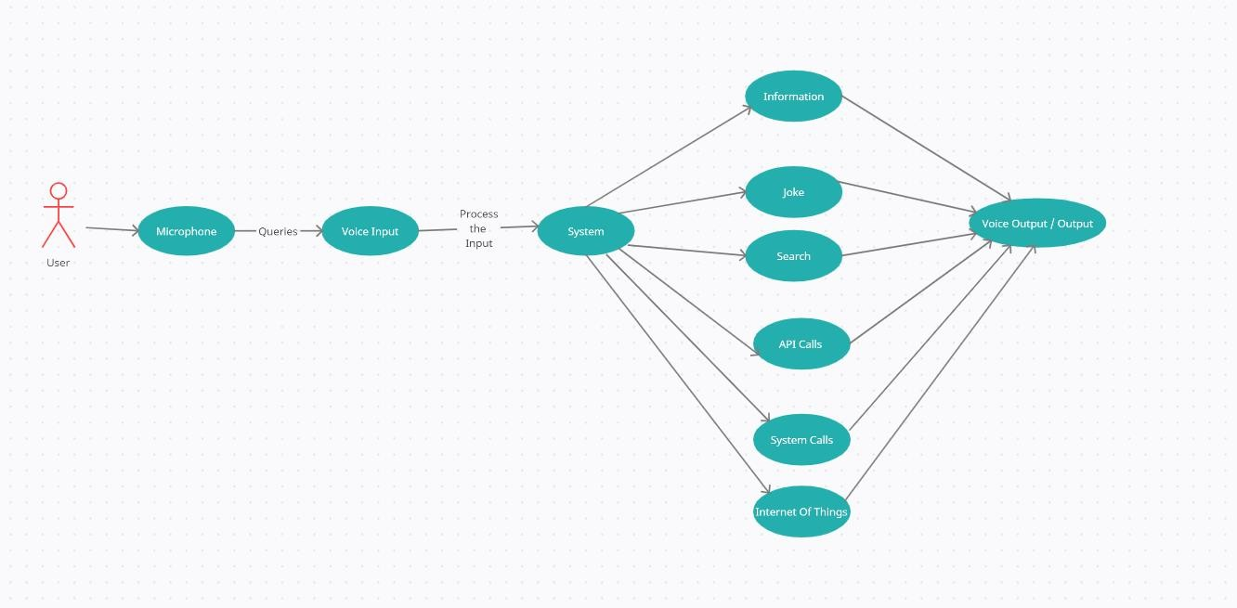
Design of Model

Slide 10

Assembly and working of Model
● Assembly of this model needs software and hardware requirements.
Software requirements are…
* Python should be 3.5 or above version
* Windows should be 7 and above
While Hardware requirement are…
* Processor : intel core i3
* RAM : 2GB
* O.S should be windows or Mac
* Microphones for input voice
Source code link :-..\my python files\Final PBL Project Test.py

Slide 11
Working of model

Slide 12
Results and discussions
Result :-
The project work of voice assistant has been clearly explained in the report , How useful it is and how we can reply on voice assistant for basic task that user want to perform. Development of the software is almost completed from our side and it is also working as we excepted. So , many modification can be done on it now.

Slide 13
Conclusion
It uses Natural Language Processing to process the language spoken by the human and understand the query and process the query and respond to the human with the result.
It perform basic tasks such as battery percentage, music, current weather, news, send email, time and etc; ultimately helping physically disabled people(blind people).

Slide 14
Future scope
* Sending emails with voice assistant
* Scheduling appointments using voice assistant
* Improve interface of voice assistant (VUI)
* Speed and Efficiency
* Intuitiveness and convenience

Slide 15
References
Source internet:-
● Youtube channel
● Goggle
● Chatgpt
Book:-
● Python programming
● Python learning

